Slide 1
Domain Analysis
On Customer Behaviors

Slide 2
Why we need domain analysis
Labels in Classification Data
While computers treat a label as just one of many labels in the models, domain analysis lets the human analyzers aware of the underlying structures and target behaviors from the label name.
Model Enhancement
Analyzers can enhance, separate and combine models based on the domain knowledge. Analyzers can find which prototypes of models are suitable from the domain knowledge.
Last week
We made hypotheses of the domain, especially for people behaviors

Slide 3
Recall the Problem Statement:
From the records of song listening,
determine whether the listeners
listen to the songs again on next 30 days.

Slide 4
Hypotheses on Customer Behaviors
Searchers Hypothesis
Searching songs can represent the active interest of the customer for the music. Therefore, searchers are likely to listen the songs again.
My Library Hypothesis
Songs saved in My Library are intended to listen later. Therefore, people are tend to listen those songs again.
Radio Listeners Hypothesis
Songs from radio are volatile. As radio is the most passive way to listen songs, people would not listen again unless the songs are popular or they actively look for the songs.

Slide 5
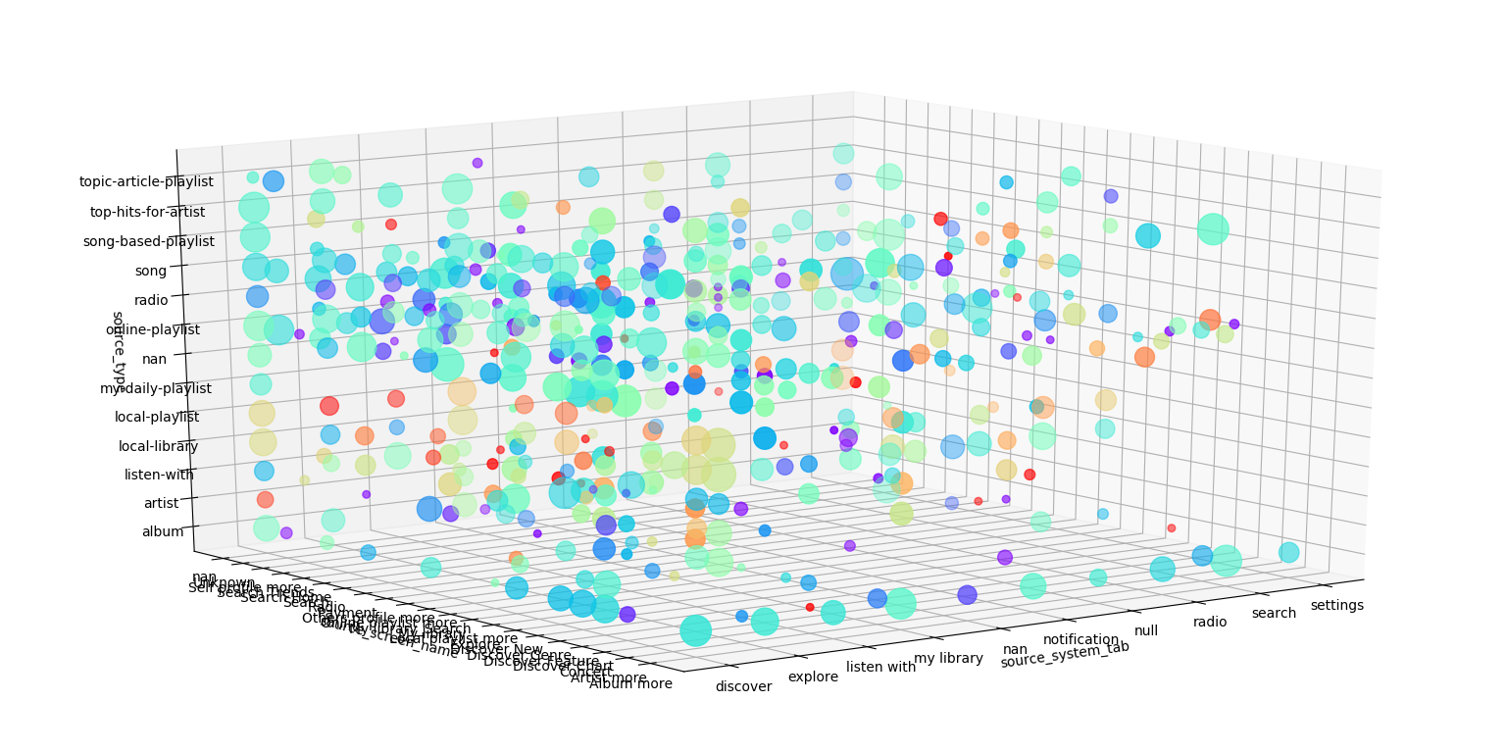
Verifying Hypotheses
Hypotheses can be verified easily by analyzing train data only.
Train data contains: target value, 3 in-app menus of songs
Significant: >10%p deviation from the average (50.35%)
Red: High Ratio
Green: About 50%
Blue: Low Ratio
Log-scaled Dot Size
on data count

Slide 6
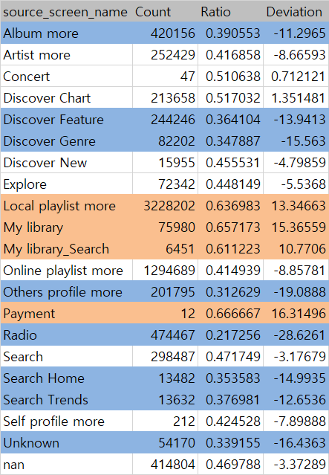
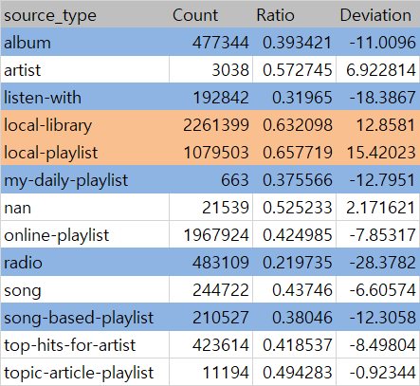
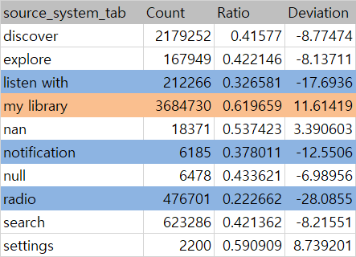
Naïve Ratio-by-menus
Units: Ratio(%), Deviation(%p)
High Ratio: my library, local library/playlists
Low Ratio: radio(less than -28%p), listen-with, Others profile

Slide 7
Acceptance of Hypotheses
Searchers Hypothesis (Not accepted)
Searching have no significant difference from the other sources of songs, on whether listening the songs again.
My Library Hypothesis (Accepted)
Radio Listeners Hypothesis (Accepted, strong)
New Phenomenon Found: Listen-with others profile
Though less significant than radio listeners, listeners from listen-with page tend to have low re-listening rate.

